Slide 1
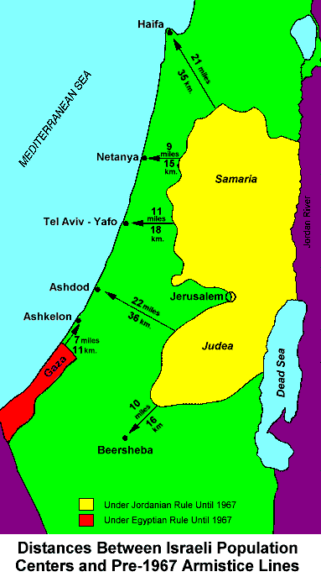

Slide 3
IN CONGRESS, JULY 4, 1776
The unanimous Declaration of the thirteen united States of America
When in the Course of human events it becomes necessary for one people to dissolve the political bands which have connected them with another and to assume among the powers of the earth, the separate and equal station to which the Laws of Nature and of Nature's God entitle them, a decent respect to the opinions of mankind requires that they should declare the causes which impel them to the separation.
We hold these truths to be self-evident, that all men are created equal, that they are endowed by their Creator with certain unalienable Rights, that among these are Life, Liberty and the pursuit of Happiness.

Slide 4
(Gen 1:1 NASB) In the beginning God created the heavens and the earth.
(Gen 1:26-28 NASB) Then God said, "Let Us make man in Our image, according to Our likeness; and let them rule over the fish of the sea and over the birds of the sky and over the cattle and over all the earth, and over every creeping thing that creeps on the earth." {27} And God created man in His own image, in the image of God He created him; male and female He created them. {28} And God blessed them; and God said to them, "Be fruitful and multiply, and fill the earth, and subdue it; and rule over the fish of the sea and over the birds of the sky, and over every living thing that moves on the earth.”

Slide 5
(Gen 3:1 NASB) Now the serpent was more crafty than any beast of the field which the LORD God had made. And he said to the woman, "Indeed, has God said, 'You shall not eat from any tree of the garden'?“
(Gen 3:15 NASB) And I will put enmity Between you and the woman, And between your seed and her seed; He shall bruise you on the head, And you shall bruise him on the heel.”

Slide 6
Amendment I
Congress shall make no law respecting an establishment of religion, or prohibiting the free exercise thereof; or abridging the freedom of speech, or of the press; or the right of the people peaceably to assemble, and to petition the Government for a redress of grievances.

Slide 7
(Gal 5:1 NASB) It was for freedom that Christ set us free; therefore keep standing firm and do not be subject again to a yoke of slavery.
(1 Pet 2:16 NASB) Act as free men, and do not use your freedom as a covering for evil, but use it as bond slaves of God.
(John 8:32 NASB) and you shall know the truth, and the truth shall make you free.”

